Slide 1

Climate Wins: Predicting Climate Change and Weather Conditions with Machine Learning
Kendra Jackson
January 5, 2024
Notes:
Good afternoon, my name is Kendra, I am a junior analyst with climate wins. Today I am here to share how our team could achieve our goals through the integration of various machine learning techniques, with three thought experiments. Without further ado, lets begin

Slide 2
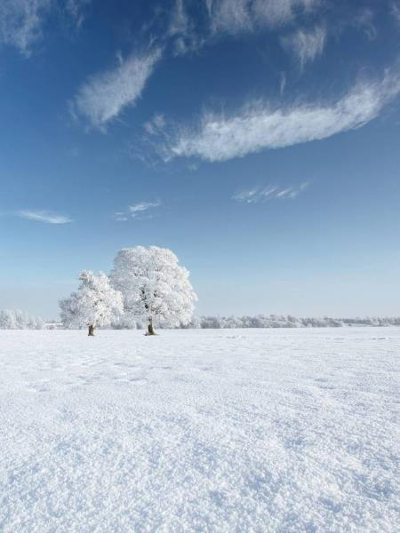
Objectives
Core Goals of ClimateWins:
Identify weather patterns outside the regional norm in Europe
Determine if unusual weather patterns are increasing
Generate possibilities for future weather conditions over the next 25-50 years
Determine the safest regions for habitations in Europe over the next 25-50 years
Notes:
For a quick review, while designing our thought experiments, these are the objectives and goals that we attempted to complete. ClimateWins first goal is: to Identify weather patterns outside the regional norm in Europe
Secondly, we want to Determine if unusual weather patterns are increasing
Third we want to Generate possibilities for future weather conditions over the next 25-50 years
Finally we want to Determine the safest regions for habitations in Europe over the next 25-50 years

Slide 3
Thought Experiments
Detect and Classify Unusual Weather
Generate Accurate Predictions and Predict the Impact of Climate Change
Assess Climate Change Across Europe
Utilize machine learning techniques to analyze imagery, weather features and time series data to detect and classify unusual weather events.
Through synthesizing weather data using a generative adversarial network (GAN), a convolution neural network (CNN) can be train to predict possible future weather conditions and climate impacts.
Utilizing a random forest model, safe living regions can be identified across Europe. An optimized random forest model can identify the most important weather features that determine safe areas versus adverse weather events.
Notes:
While keeping these objectives in mind, three thought expriments were developed. number one: detect and classify unusual weather. To do this we would utilize machine learning techniques to analyze imagery, weather features and time series data to detect and classify unsual weather events. The second experiment would be to generate accurate predictions and predict the impact of climate change. this would be achieved through synthesizing weather data using a generative adversarial network (GAN). This data would then be taken and used by a Convolution neural Network (CNN) to train on, the result would be a CNN that could predict possible future weather conditions and climate impacts. Finally, our last thought experiments is to assess climate change across Europe. Through the use of a random forest model, we should be able to determine safe living regions across Europe. Additionally, an optimized random forest model should be able to identify features that can be attributed to an areas being safe or prone to adverse weather events.

Slide 4
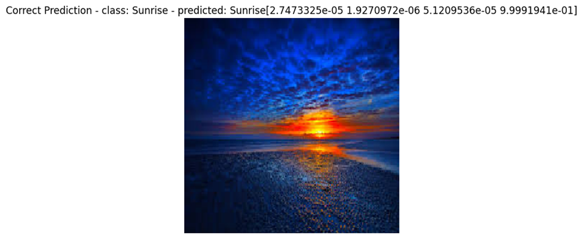
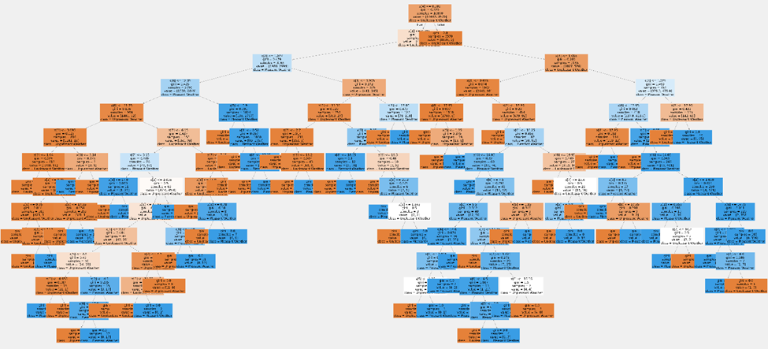
Required Machine Learning Models
Random Forest:
Convolution Neural Network (CNN) and Recurrent Neural Network (RNN):
General Adversarial Network (GAN)
Sorts data into categories with a true/false method. Creates multiple trees where each tree is trained on a random sample with the final result being an average of each tree produced.
Benefits:
Reduces overfitting through averaging
Can predict weather outcomes like temperature or precipitation
Produces artificial data based on real data points. Involves two networks working against each other to create more realistic artificial data.
Benefits:
Can generate synthetic data for training
CNNs detect spatial patterns while RNNs detect sequences by analyzing past inputs.
Benefits:
Effectively analyzes images, including radar imagery
RNNs can model time series data to forecast weather conditions
Combination of the two networks handle complex video analysis
Notes:
In order to perform our experiments, multiple machine learning models are needed. For a brief overview there are 4 models required to achieve our goals. : a random forest model which Sorts data into categories using a true/false method. It creates multiple trees where each tree is trained on a random sample. the final result being an average of each tree produced.
Some fo the Benefits are:
Reduced overfitting through averaging
And prediction of weather outcomes like precipitation of temperature changes. The second and 3rd model are Convolution Neural Networks or CNNs and Recurrent Neural Networks or RNNs. CNns excel with spatial pattern recognition while RNNs detect sequences by analyzing past data. These two models are both extremely beneficial as CNNs can effectively analyze images, like weather radar imagery and RNNS can model time series data to forecast weather conditions. In conjunction with the other, these two models can handle complex video analysis and could be used to predict a variety of weather events using different source data. Finally the last model we need is a GAN or General Adversarial Network. These models produce artificial data based on real data points. It works by having two networks competing against one another in order to create more realistic data, this is beneficial as we could generate synthetic data for training and prediction.

Slide 5
Necessary Additional Data
Dangerous Weather Classifications
Identification of the attributes that categorizes weather as extreme or dangerous
Radar Imagery
Radar data of events that links to the regional data of weather stations used in this analysis
Weather Event Data
Records of extreme weather events across Europe
Disaster Data
Data linking to the outcome of weather events to assist with classification of dangerous weather
(ex. Destroyed houses, drought)
Event Repercussion Data
Information on injuries. Illness and deaths connected to an extreme weather event
Notes:
In order to achieve our goals and bring our thought experiments to reality, some additional data is required: dangerous weather classification that identifies attributes that categoirize weather as extreme or dangerous. Radar imagery data of weather events within the regions are current data covers would be beneficial. Records of extreme data events across Europe is a must and this should include records of extreme weather events across Europe as well as data that links the extreme weather event to negative outcomes like destroyed houses, drought, floods, injuries, illnesses, and even deaths

Slide 6
Thought Experiment 1 : Detect and Classify Unusual Weather
Hypothesis
Using CNNs, RNNs, and Random Forests, we will be able to detect and classify weather events using satellite imagery and historical weather data.
Objective
To identify if unusual weather patterns are forming or occurring.
Approach
CNN: analyze satellite images to identify visual patterns associated with severe weather events.
RNN: analyze historical time-series data to determine the sequences leading up to severe weather events (for early detection and classification accuracy).
Random Forrest: extract weather features from historical data and determine classification of pleasant or unpleasant weather.
Notes:
The first thought experiment we could complete with the proposed data and machine learning models would be to detect and classify unusual weather:CNN: analyze satellite images to identify visual patterns associated with severe weather events
RNN: analyze historical time-series data to determine the sequences leading up to severe weather events (for early detection and classification accuracy)
Random Forrest: extract weather features from historical data and determine classification of pleasant or unpleasant weather

Slide 7

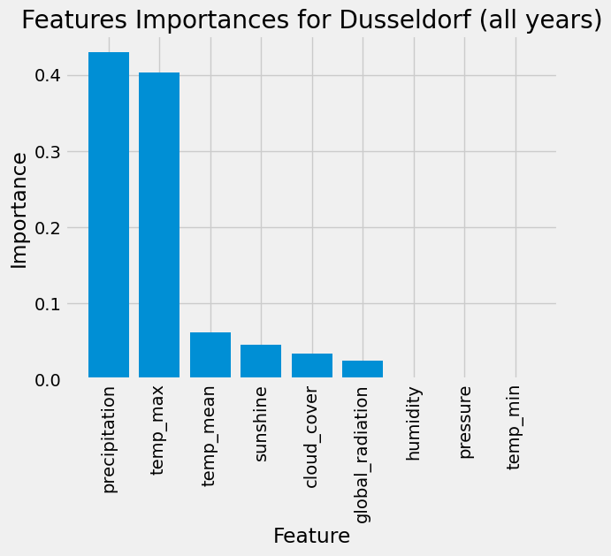
Thought Experiment 1: Continued…
Results:
Random Forrest models have proven their capacity to distinguish factors that influence the classification of data.
CNNs can differentiate between weather conditions such as cloudy and rainy.
(image shows an accurate prediction of “sunrise”)
Conclusion:
This approach successfully identifies features that have increased impact on ways in which data is classified. This approach points to weather features that contribute to unusual or extreme weather events.
Notes:
We believe that this approach should work as it has previously

Slide 8
Thought Experiment 2: Generate Accurate Predictions and Simulate the Impact of Climate Change
Hypothesis
Through the use of multiple machine learning algorithms, the impact of climate change can be simulated and predicted accurately.
Objective
Generate possible climate changes over the next 25-50 years based on current trends.
Approach
Use GANs to generate synthetic weather data with different climate change scenarios.
Train RNNs on both real and simulated data to forecast future conditions with a focus on key variables contributing to climate change.
Analyze results through a Random Forest to identify which types of weather patterns contribute most to climate change.

Slide 9

Thought Experiment 2: Continued…
Expected Outcome:
An algorithm by which potential future climate changes can be predicted allowing stake holders to plan for extreme weather events.
Conclusion:
This approach allows for the identification of key factors contributing to climate change. Once these factors have been identified, a GAN can be used to simulate areas in which these factors and changes have or may occur.

Slide 10
Thought Experiment 3: Assess Climate Change Across Europe
Hypothesis
Through optimization of a random forest model, key weather variables can be determined allowing for tracking and determination of climate change and safe living areas across Europe.
Objective
Determine the safest regions within Europe for habitation over the next 25-50 years.
Approach
Optimize hyperparameters of the model.
Compare unoptimized and optimized results.
Determine key weather features indicating climate change or extreme weather event.s

Slide 11
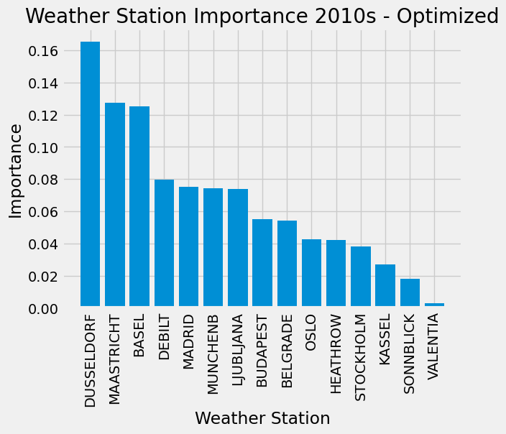
Thought Experiment 3: Continued…
Expected Outcome:
Increased accuracy from optimization.
Accurate representation of feature importance (weather features) in climate analysis.
Conclusion:
This approach provides results demonstrating which regions are weighed more heavily based on their features. Through looking at this, we can determine which areas have more of these extreme features like precipitation or an increase in average temperature to determine safe versus potentially not safe regions.

Slide 12
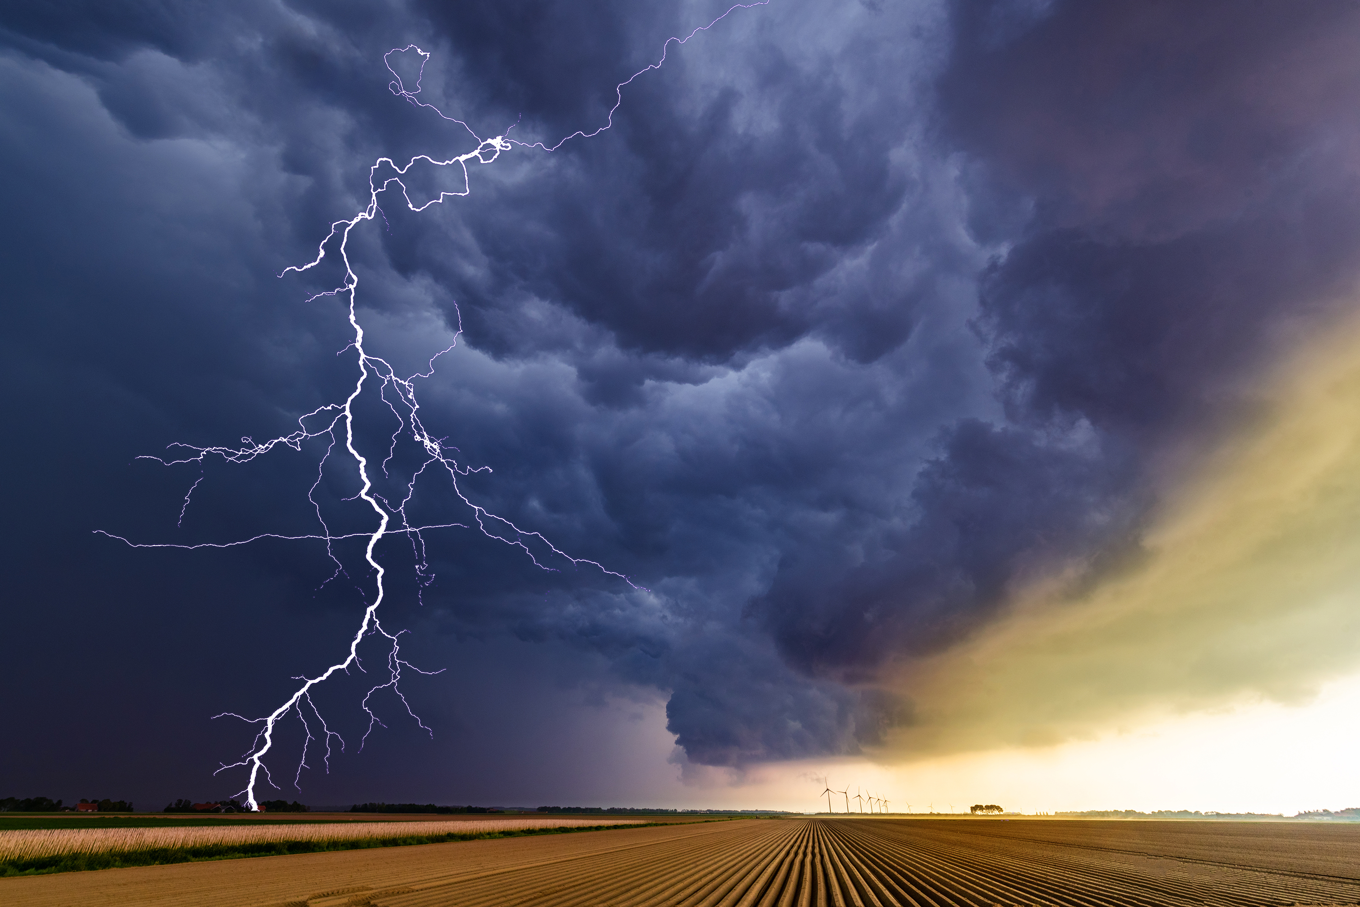

Recommendations:
Immediate Analysis:
The use of a Random Forest model will allow for immediate determination of feature importance identifying regions and weather variables that are experiencing changes to weather patterns or abnormal weather. This can also be adapted to look at data spanning decades to determine if weather events are increasing.
Implementation of CNNs to analyze satellite data and weather imagery will assist in ClimateWins goal of weather classification.
Future Analysis:
Implementation of CNNs and RNNs to analyze satellite data and weather imagery will assist in ClimateWins goal of weather classification.
Invest in developing GANs for longer-term scenario simulation, helping ClimateWins plan for potential future climate crises.

Slide 13


Summary:
Scenario 1 is strong in its ability to classify weather events. CNNs, RNNs and Random Forest models have proven their capacity to determine and categorize features. This aligns with ClimateWins goal of unusual weather feature categorization.
Scenario 2 is innovative and offers results for two of ClimateWins goals but is complex in nature and has risks that lie within the nature of a GAN that could comprise accuracy.
Scenario 3 provides real time information on how regional climates have changed across Europe. It provides insight into which features are attributed to weather events and which areas within Europe are experiencing them.
Recommended Scenario for Immediate Results:
Both scenarios 1 and 2 provide real-time results that align with some of ClimateWins’ goals. They are the most feasible and provide comprehensive analysis of factors affecting climate across Europe. These scenarios can identify abnormal weather patterns, an increase in unusual weather, and determine the safest regions for which Europeans should live in.

Slide 14
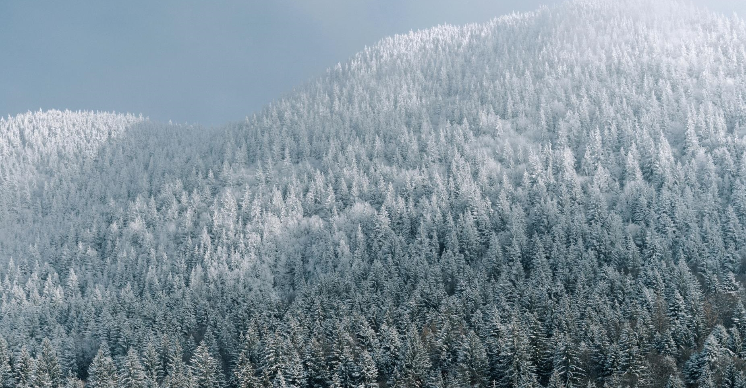
THANK YOU
Questions? Contact Me:
Kendra Jackson
kenzyjackson@gmail.com
Scripts: Github
Images: PowerPoint Stock Images

